Slide 1
Legolas Summer 2024
Adi Timin, Miller Gruen, Dr Lowe

Slide 2
Github sites
Dr. Lowe's Github site
https://github.com/mlowe308/Legolas_textCellLoc.git
Understanding the Gaussian function and Gaussian noise
teaching_Gaussian.docx
Teaching_Gaussian.ipynb
Brendan and Audrey's files with modifications to enable their code to run on Dr. Lowe's laptop. Modifications are probably in core.py, manual.py, and final_config.yaml
https://github.com/mlowe308/BrendanAudrey_Capstone_Legolas

Slide 3
Libraries
opencv – an open-source computer vision and machine learning software library geeksforgeeks.org
pyyaml – formats data to be readable and to interact with scripting languages https://pypi.org/project/PyYAML/
RPyC - a main-loop that accepts incoming connections and calls. Three built-in servers: Forking - forks a child process to handle each incoming connection; Threaded - spawns a thread to handle each incoming connection; Thread Pool - assigns a worker-thread for each incoming connection from the thread pool; if the thread pool is exhausted, the connection is dropped https://rpyc.readthedocs.io/en/latest/docs/servers.html Expand on this one
matplotlib - a comprehensive library for creating static, animated, and interactive visualizations in Python pypi.org
NumPy - a Python library used for working with arrays. It also has functions for working in domain of linear algebra, fourier transform, and matrices. w3schools.com
scipy - a scientific computation library that uses NumPy underneath w3schools.com
torchvision - is part of the PyTorch project, an open-source machine learning framework. The torchvision package consists of popular datasets, model architectures, and common image transformations for computer vision. pytorch.org
paramiko - provides the foundation for the high-level SSH library Fabric, for common client use-cases such as running remote shell commands or transferring files paramiko.org
sv_ttk - allows you to easily apply the Sun Valley theme to your Tkinter/ttk app github.com
Tkinter - Python standard GUI framework, "a Python binding to the Tk GUI toolkit",

Slide 4
Insert picture of camera location Insert picture of longer screws in y-limit switch Insert picture of the Lego thing that holds the pH wire straight up For Pi 2 (vertical Pi), two standoffs are between the Buildhat and Pi boards. Followed recommendation in video. Pi 1 does not have standoffs. For Pi 1, two Lego pieces on the side (without the microHDMI) have been removed. Not sure what the purpose was of the two pieces but they got in the way of manipulating the boards. Photos of where they used to be are on Dr. Lowe's phone.
Hardware modifications

Slide 5
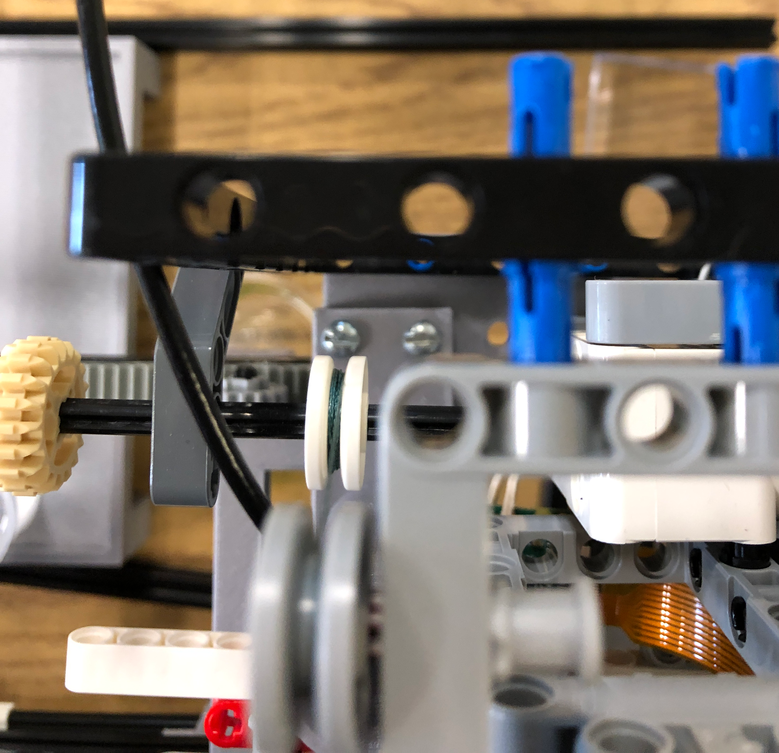
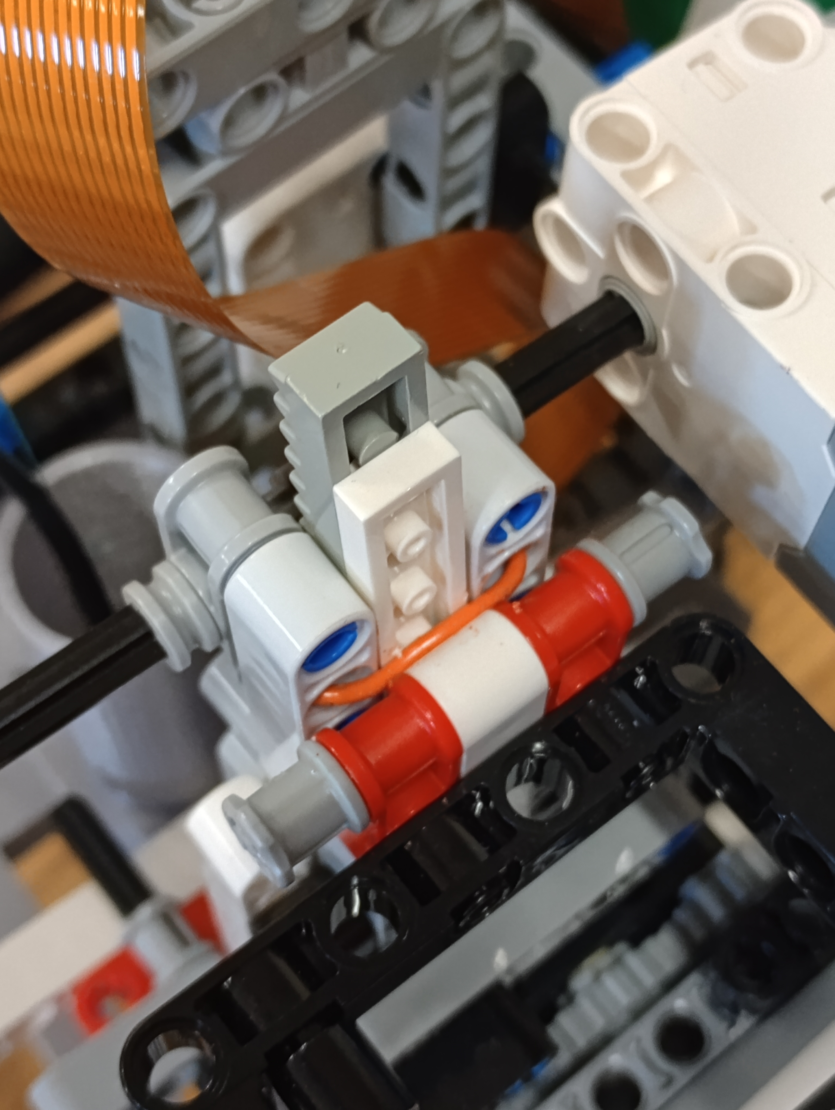
~8/2023 Replaced 2 Lego pins with screws to hold pH sensor more securely.
5/31/24 Work on pipetting water into specified wells. Stabilize rail for plunger by jamming wire behind rail.

Slide 6
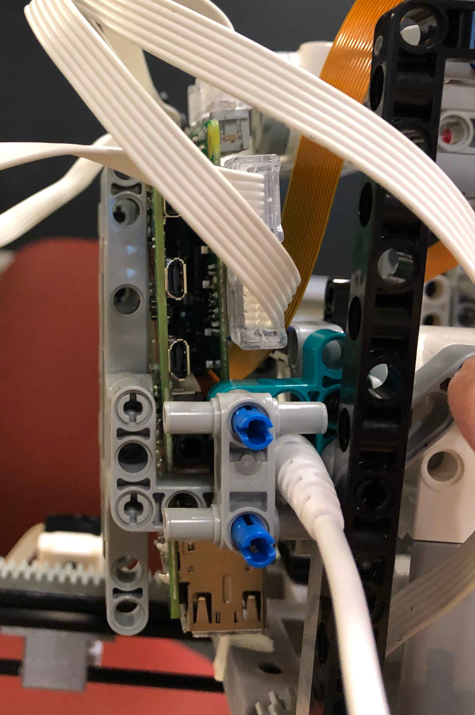
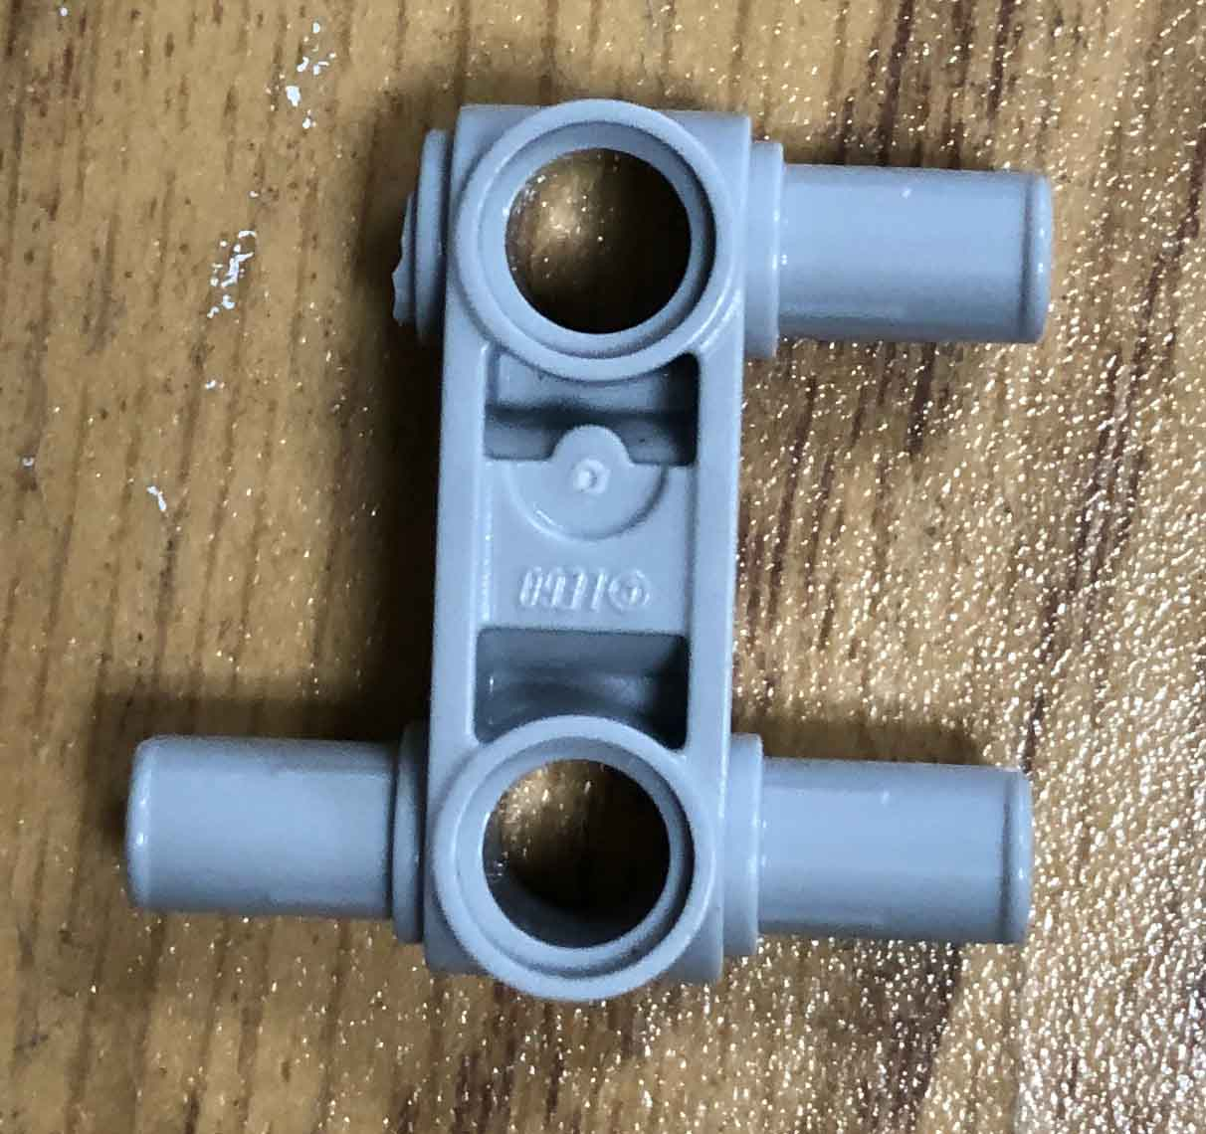
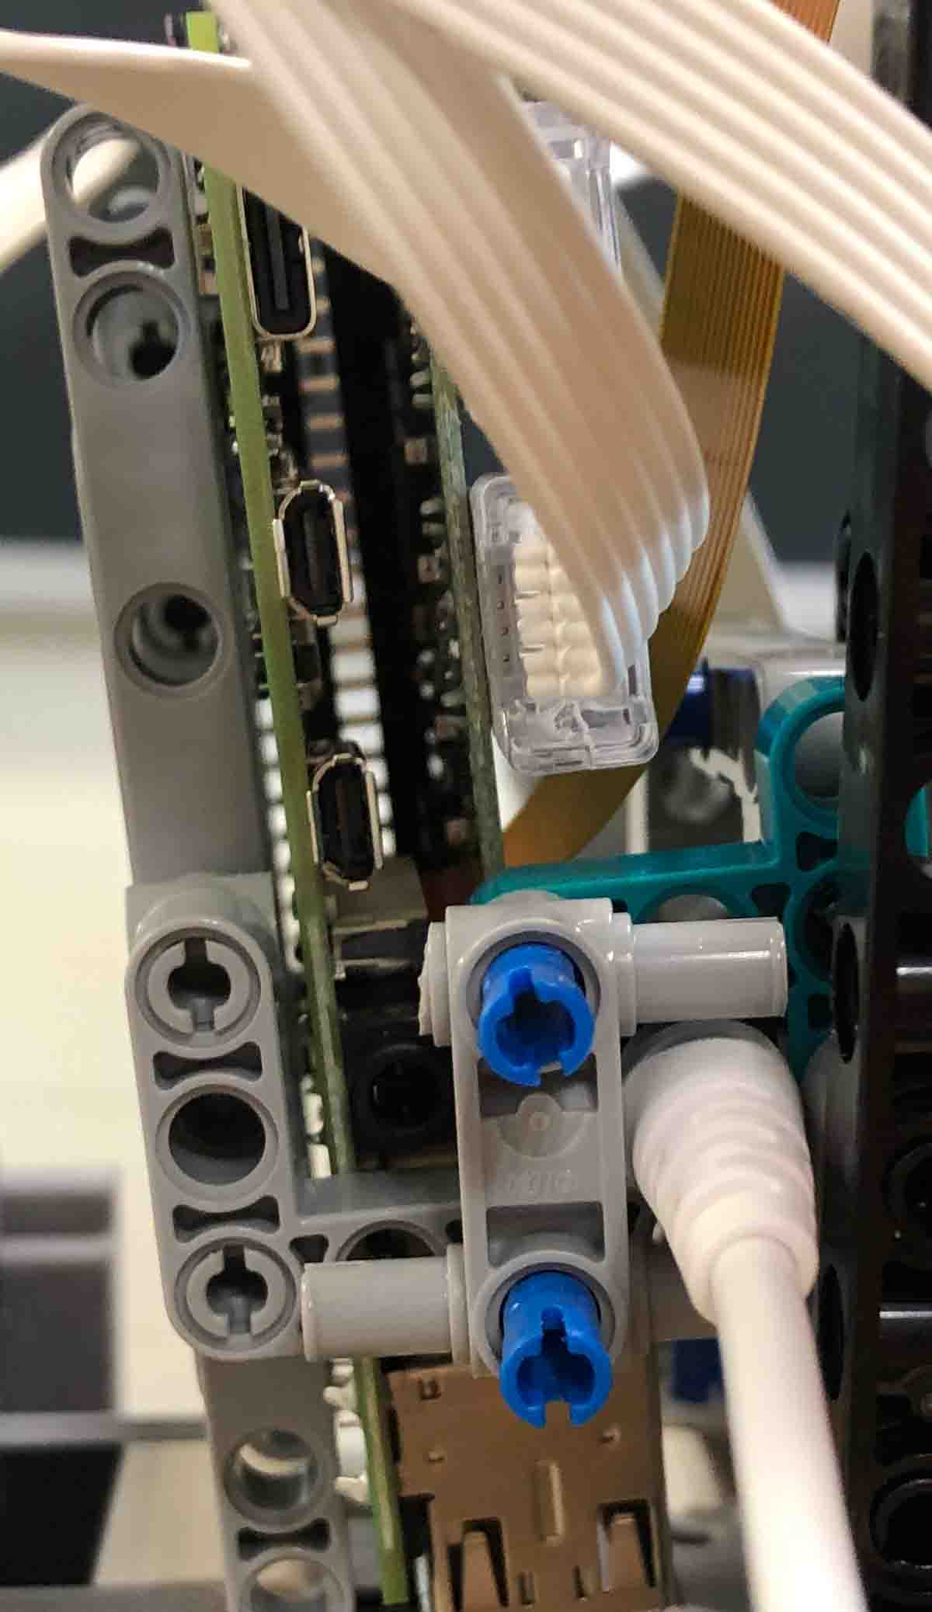
6/18/24 Cut Lego piece on Pi2 to make it easier to access ports on Pi2.
Cut Lego piece
Original
Pi2 microHDMI ports are now accessible

Slide 7
Aspirating and dispensing liquid Volume calibration

Slide 8
Test: aspirating & depositing liquid
Calibration 1.0: 6-point calibration
Trial | Well | Expected Result (g) | Actual Result (g)
1 | 1 | 0.1 | 0.130
 | 2 | 0.2 | 0.204
 | 3 | 0.3 | 0.205
2 | 1 | 0.1 | 0.130
 | 2 | 0.2 | 0.207
 | 3 | 0.3 | 0.207
3 | 1 | 0.3 | 0.277
 | 2 | 0.2 | 0.199
 | 3 | 0.1 | 0.07
4 | 1 | 0.3 | 0.269
 | 2 | 0.2 | 0.199
 | 3 | 0.1 | 0
5 | 1 | 0.3 | 0.276
 | 2 | 0.2 | 0.204
 | 3 | 0.1 | 0.077
Incorrect aspiration, not enough liquid for third well. The third well is always low. The second well always gets the right amount of liquid. For the first well, if we command 0.3 g to be dispensed, it will normally be 0.27, whereas if we command 0.1 g to be dispensed, it will normally be 0.13.
Our next step is to recalibrate once more by using 7 calibration points.
(Full data sets from all trials are in Adi’s notebook)

Slide 9
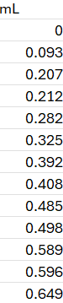
Test: aspirating & depositing liquid
Calibration 2.7
Calibration 1.1
A combination of an erroneous 6-point calibration & an accurate 7-point calibration (with one point at 0 g). The best fit of these resulted in numbers that were closer to what we expected, which proved to be useful. We then explored changing the slope and y-intercept of the best fit line to obtain better results.
User-adjusted slope: y = 885x
X is the volume aspirated during calibration in mL
Y is the motor rotation
Well | Desired (g) | Actual (g)
 | 0.6 | 0.620
1 | 0.3 | 0.276
2 | 0.1 | 0.099
3 | 0.2 | 0.208
Well | Desired (g) | Actual (g)
 | 0.6 | 0.607
1 | 0.3 | 0.264
2 | 0.2 | 0.200
3 | 0.1 | 0.139
When commanded to aspirate 0.6 g of liquid, the Legolas was expected to also dispense 0.6 g, but it was off by a small margin. Then, it was commanded to aspirate 0.6 g and to distribute that liquid into three different wells in varying volumes. The desired result was 0.3 g, 0.2 g, and 0.3 g, and the results we got were off by margins we deemed not significant at this point.

Slide 10
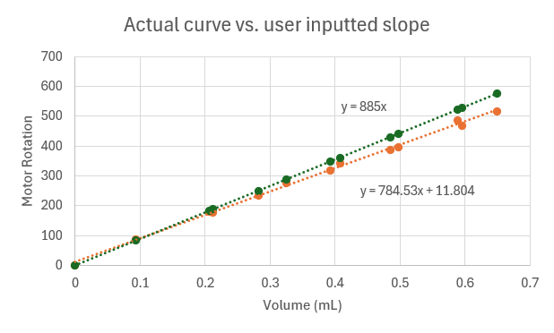
Using volume calibration points with a user selected slope increased accuracy
Calibration 2.7
Orange Line: Actual Calibration Data as collected manually
Green Line: Adjusted data inputted manually into config.yaml

Slide 11
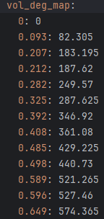
Current volume calibration in config.yaml
User-adjusted slope: y = 885x
X is the volume aspirated during calibration in mL
Y is the motor rotation

Slide 12
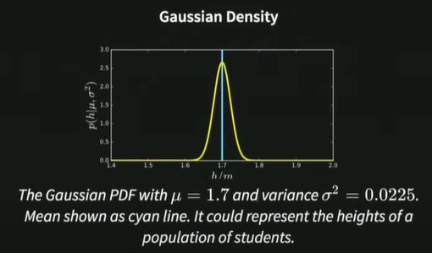
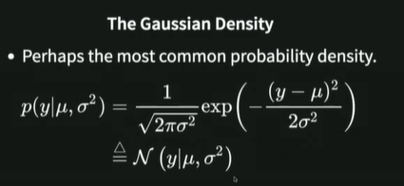
17.40 Gaussian density

Slide 13
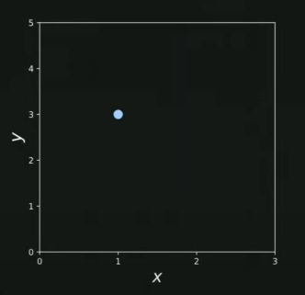
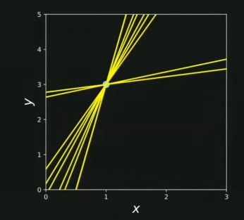
24.40 Undetermined system
Two unknowns and one observation: y₁=mx₁ + c (model)
One observation of y₁, x₁. Linear eq. Can compute m given c.
Lines are consistent with observation.
Sample a value of c. Fit line. Get distribution of lines.
Talk about uncertainties in the model.
aleatoric uncertainty
Observations of planet: noise from fluctuating atmosphere - truly uncertain.
epistemic uncertainty – shouldn’t put probabilistic distributions for c
Talk about uncertainty about f(x). Not a classical approach for machine learning.

Slide 14
NEW Depo volume calibration June 28, 2024
A new calibration brought it closer to zero, though still with a -38 offset (the value at zero was even lower,
~-73). We used this calibration and it yielded results seen on the right, which we deemed accurate enough to go through with, attributing the error to the imprecision of the pipetting, as there would always be a droplet on the end of the tip of the syringe - >0.01 mL, closer to 0.02 mL (see next slide for absolute and percent error). The y-intercept offset was attributed to the fact that the plunger wasn’t in full down when pis were turned on, which is when the motor position is set to 0. Interestingly despite this, the previous calibration still works when restarting the system.
As there were still inaccuracies in the depo volume measurements once tested weeks later, a new calibration was created. Though the results seemed accurate at first, they eventually started to deviate more and more, and a look at config.yaml revealed that there was an incorrect data point potentially messing up the curve, which was discounted as an outlier. However, the curve had a y-intercept at -255, which initially seemed incorrect because in most previous trials it was in the vicinity of zero.

Slide 15
Expected values (mL) | Measured values (mL) | Percent difference | Absolute difference (mL)
0.5 | 0.46 | -8.0 | -0.04
2 | 1.94 | -3.0 | -0.06
2 | 2.045 | 2.3 | 0.045
0.1 | 0.133 | 33.0 | 0.033
1 | 1.052 | 5.2 | 0.052
0.5 | 0.526 | 5.2 | 0.026
1.5 | 1.574 | 4.9 | 0.074

Slide 16
Bayes' theorem

Slide 17

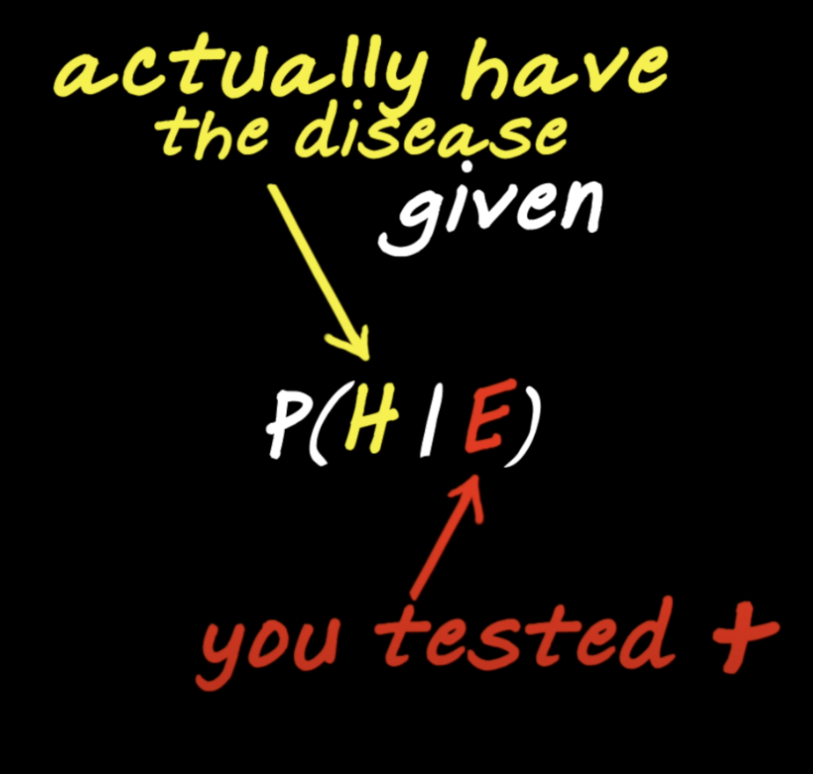
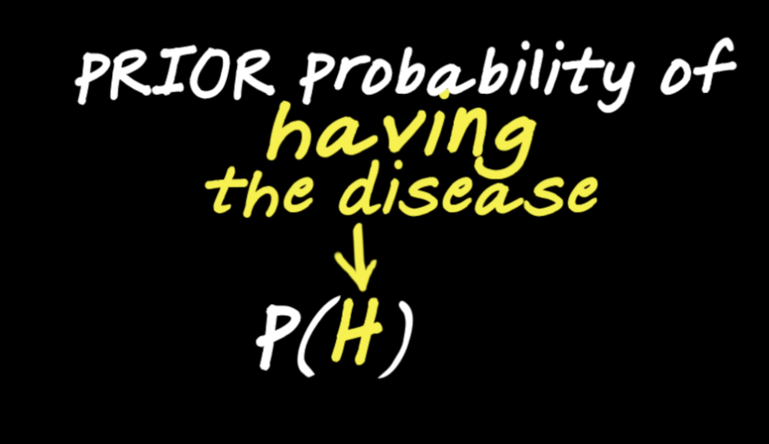
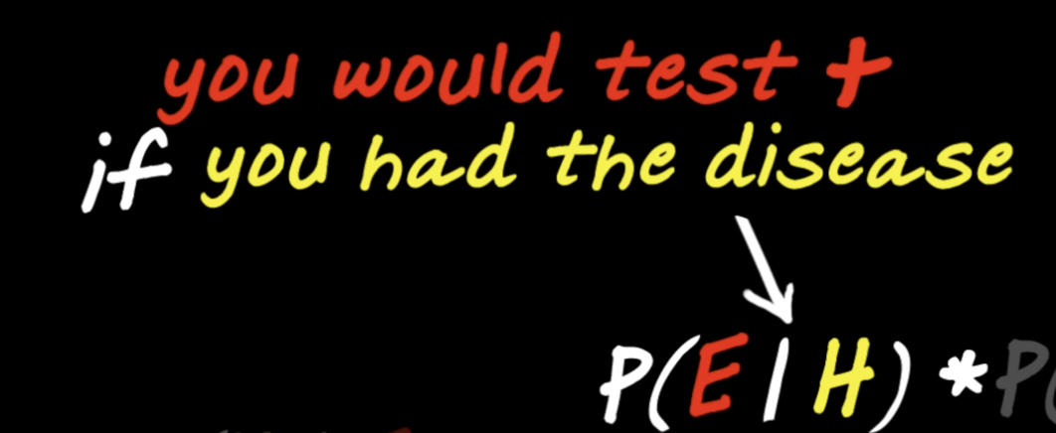
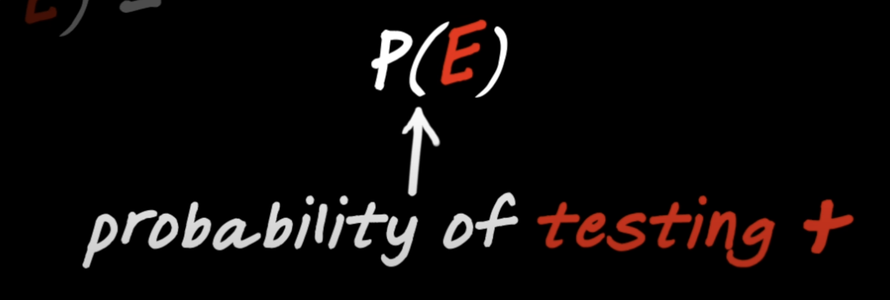
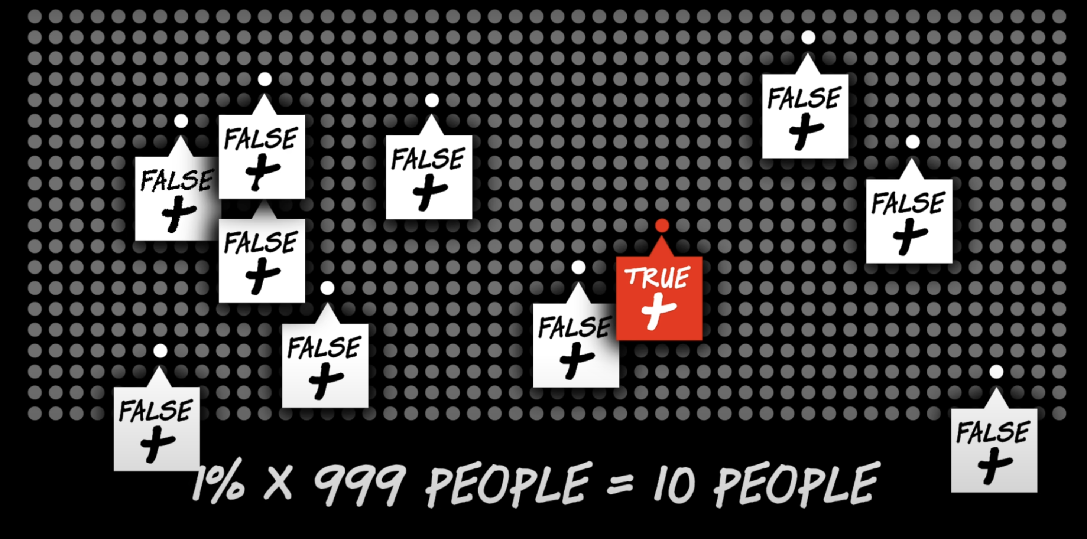

Bayes’ Theorem example
Population consists of people with disease and without disease. P(H) = .001;
P(E|H) = .99 correct result; P(E| not H) = .01 false positive
Rate of false positives is high and the number of peope with no disease is big, leading to low prob of having disease even after testing positive.
https://youtu.be/R13BD8qKeTg?si=nmU_UWsTjxJRObhO

Slide 18
P(E|H) * P(H)
P(H|E) =
P(E|H) * P(H) + P(E|-H) * P(-H)
0.99 * 0.001
= 0.09
0.99 * 0.001 + 0.01 * 0.999

Slide 19
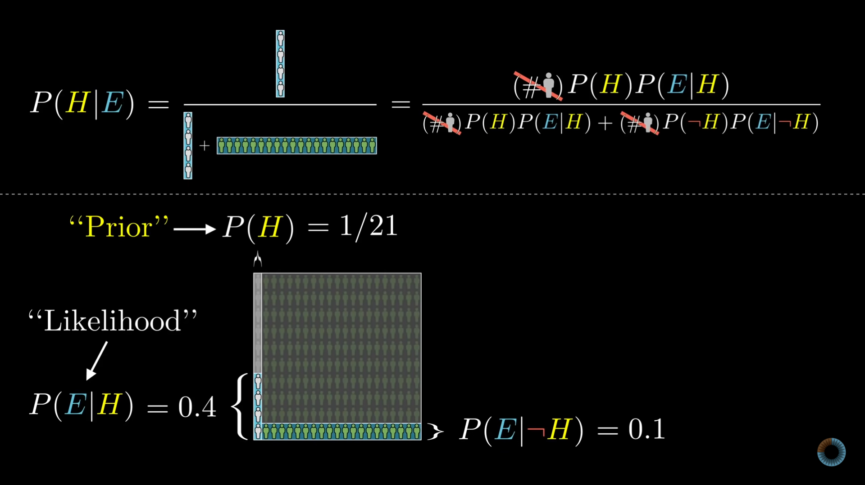
IMPORTANT
GIVEN you are shy, there is a 4/24 chance of you being a librarian
Given a person with a shy personality, what is the probability of him being a librarian or farmer?
Probability of a librarian in population of librarians and farmers = 1/21
P(E) = probability of being a shy person
P(H|E) = (1/21)*0.4 / [(1/21*.4) + (20/21)*.1] = 16.7%
P(E|H) = probability of being shy GIVEN you are a librarian
P(E|xH) = probability of being shy GIVEN you are a farmer

Slide 20
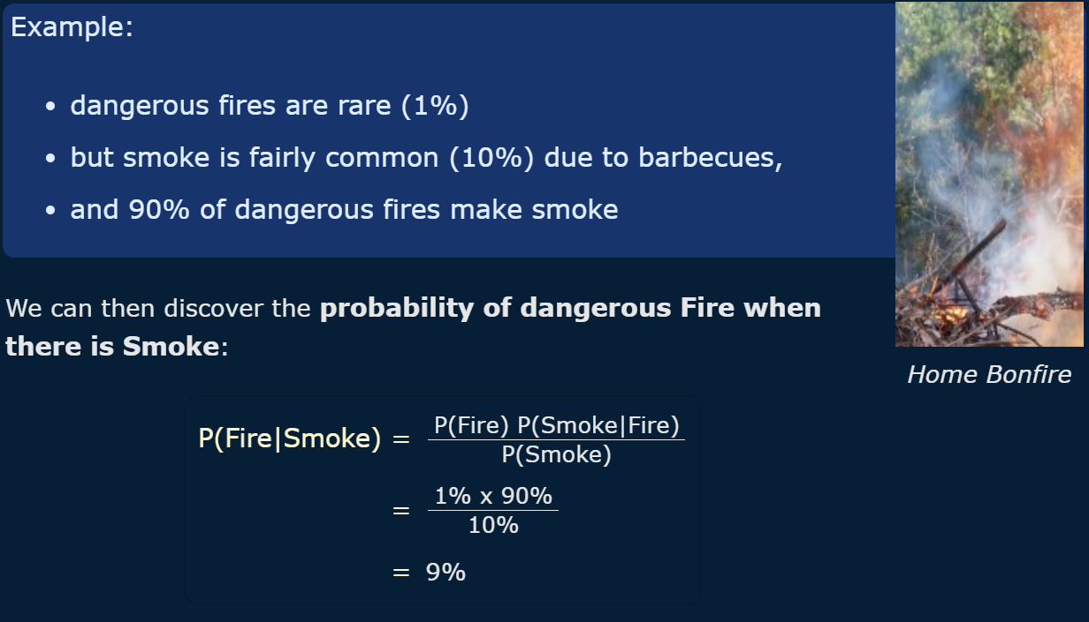
Dangerous fires vs non-dangerous fires (barbecue, fireplace, etc)

Slide 21
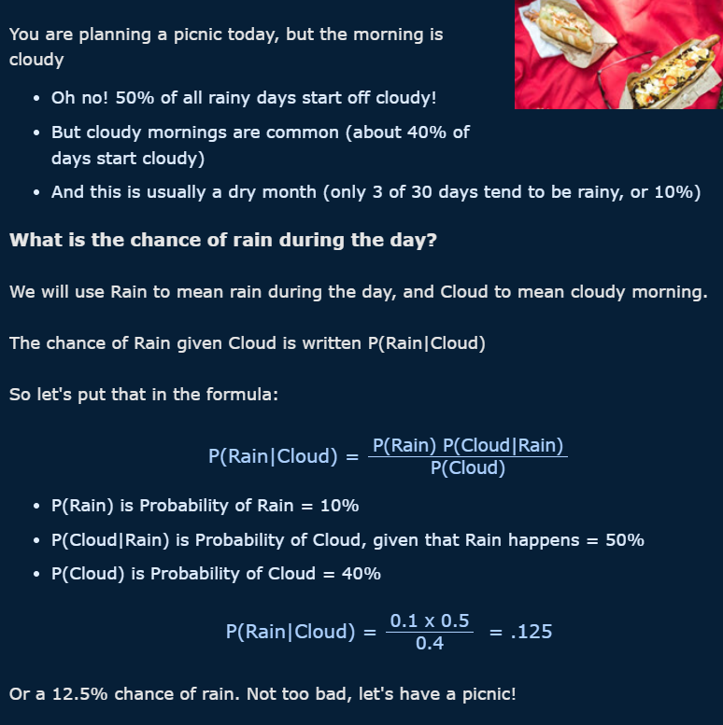
All days are either rainy or not rainy.
There is a 10% chance of a random day being rainy
New information: you see clouds
On days with rain it is more likely, 50%, to start cloudy
On all days, both rainy and not, there is a 40% to start cloudy
Because there are so many not rainy days, even though rainy days are more likely to be cloudy, cloudy days cannot be more likely to preclude rain

Slide 22
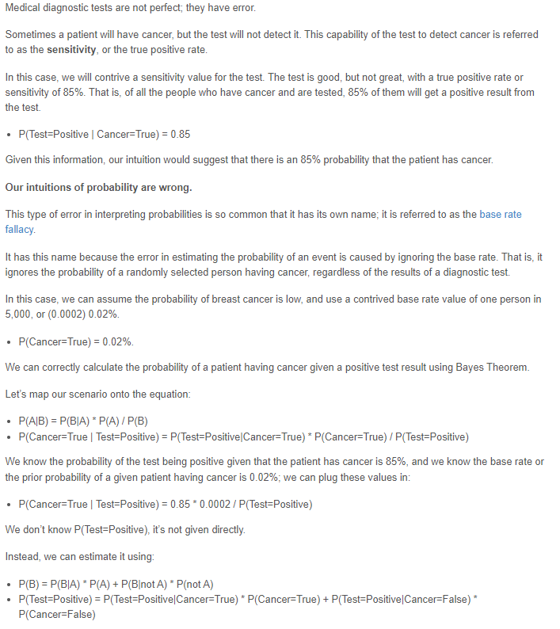
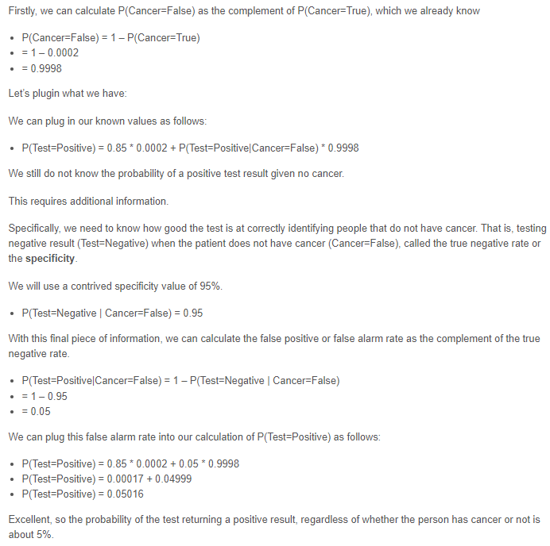
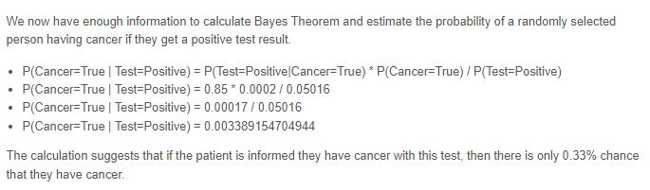
https://machinelearningmastery.com/bayes-theorem-for-machine-learning/

Slide 23
Gaussian processes
Gaussian Processes are a nonparametric supervised learning method used to solve regression and probabilistic classification problems.
stochastic process (a collection of random variables indexed by time or space)
The advantages of Gaussian processes are: The prediction interpolates the observations
The prediction is probabilistic so that one can compute empirical confidence intervals and decide based on those if one should refit the prediction in some region of interest.

Slide 24
Reading and videos
https://thegradient.pub/gaussian-process-not-quite-for-dummies/
The above website also links to a good Youtube video by Dr. Richard Tyler: https://youtu.be/92-98SYOdlY
I found it easier to watch the video and then go back to the reading, which summarizes the video.

Slide 25
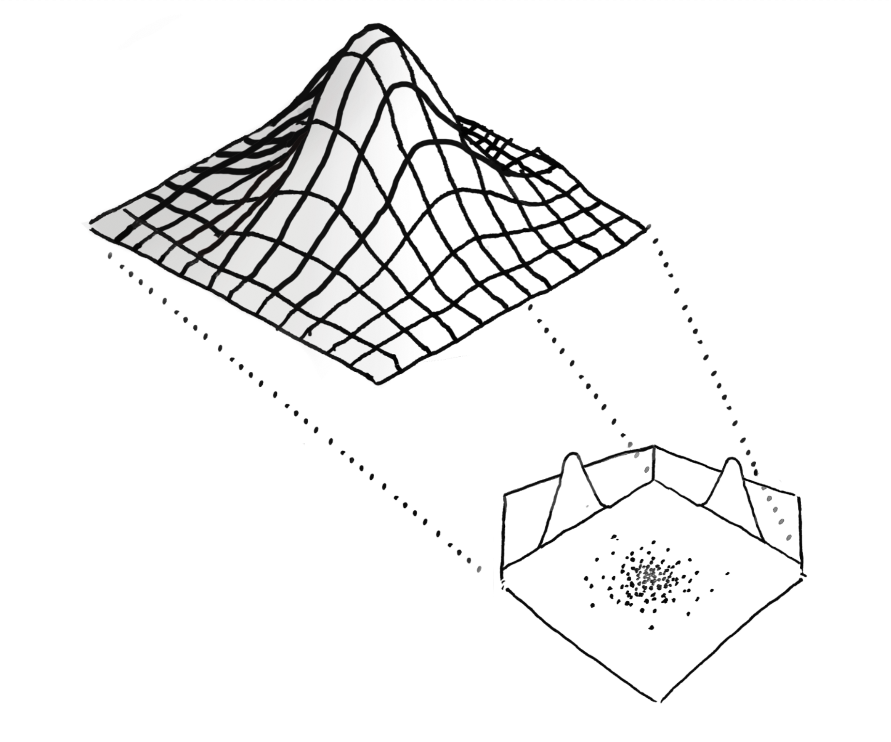

Slide 26
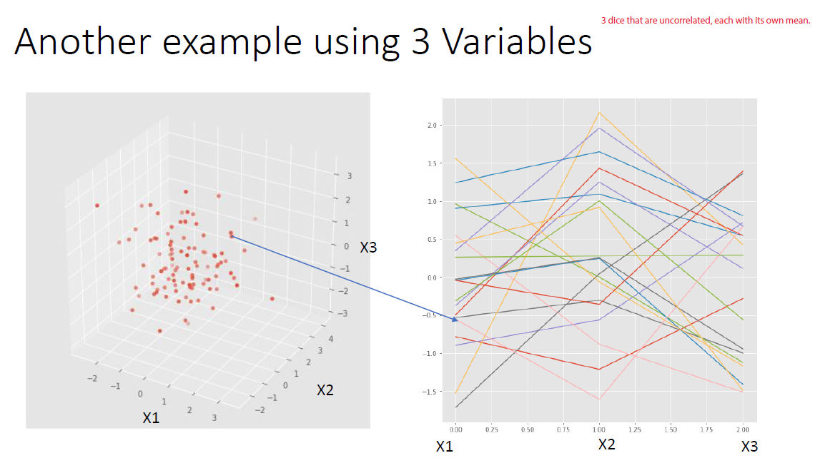

Slide 27
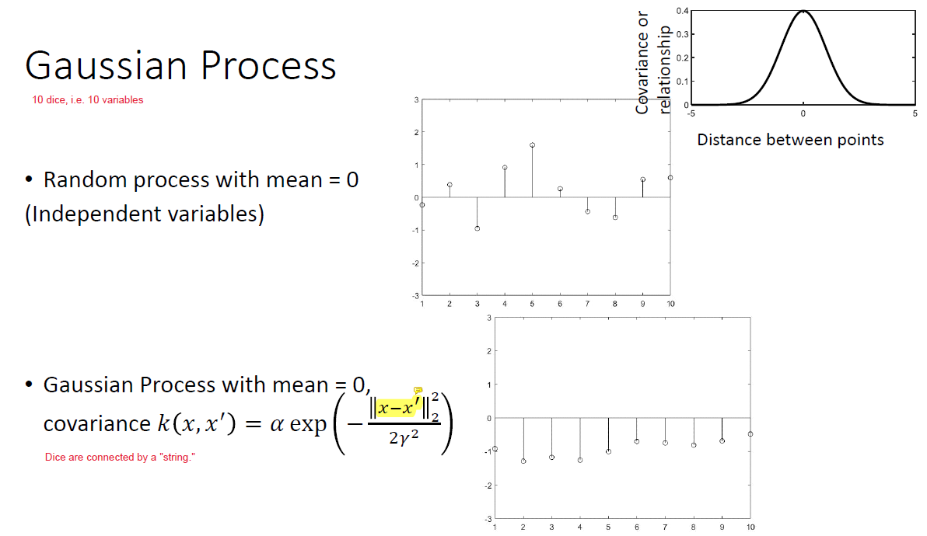
IMPORTANT

Slide 28
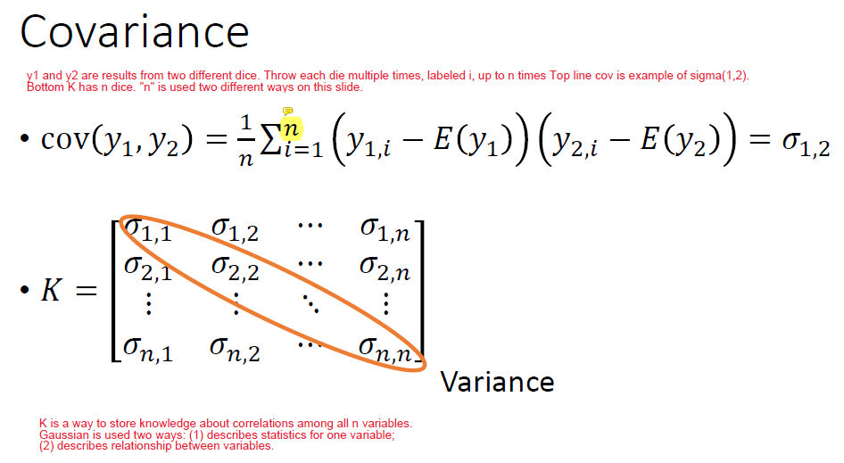
See handwritten example to compute 2x2 covariance matrix using top equation.
Also see handwritten example to compute 2x2 cov matrix using rbf kernel.

Slide 29
Working combination of packages Timeout errors

Slide 30
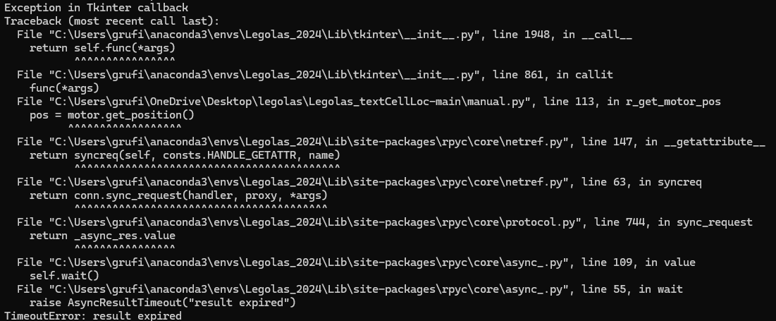
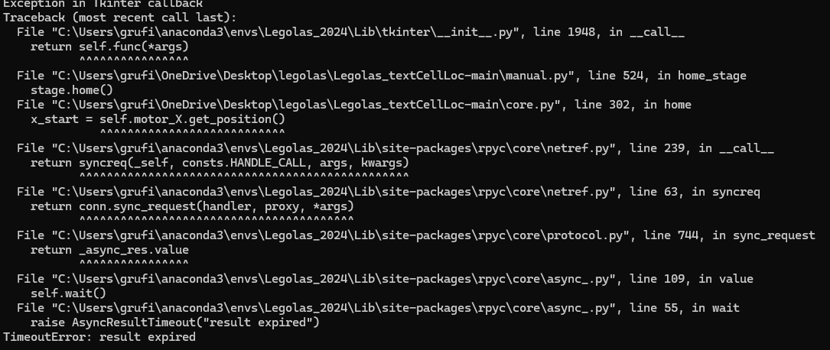
Timeout error
Timeout error consistently occurs 90-100 seconds after resetting the server
Tried replacing hardware with:
Pi2, 8 GB RAM
Buildhat on Pi2
Timeouts still occurred but with new Buildhat, the times were >=100 sec. A little erratic. Occasionally there was no timeout.
Concluded that the main problem was a software conflict that developed when Debian 11 was installed on Pis and new libraries were installed.

Slide 31
Software combination that seems to work
On Pi:
Debian 11, Python 3.9.2, rpyc 5.3.1, buildhat 0.5.8
Create environment .rpyc5.3.1_test_env
On PC or Mac:
Windows 10 (maybe 11), Darwin OS
Python 3.12.3, rpyc 5.3.1
Create environment Legolas_2024
Note: George tried to install conda on Pi2 (1 GB not enough, needs 4GB or 8GB RAM) and walk back Python version to 3.7. ___. In rpyc documentation, this is the latest version that was tested. Errors.
See handwritten notes for more information on testing.

Slide 32
pH Sensor

Slide 33
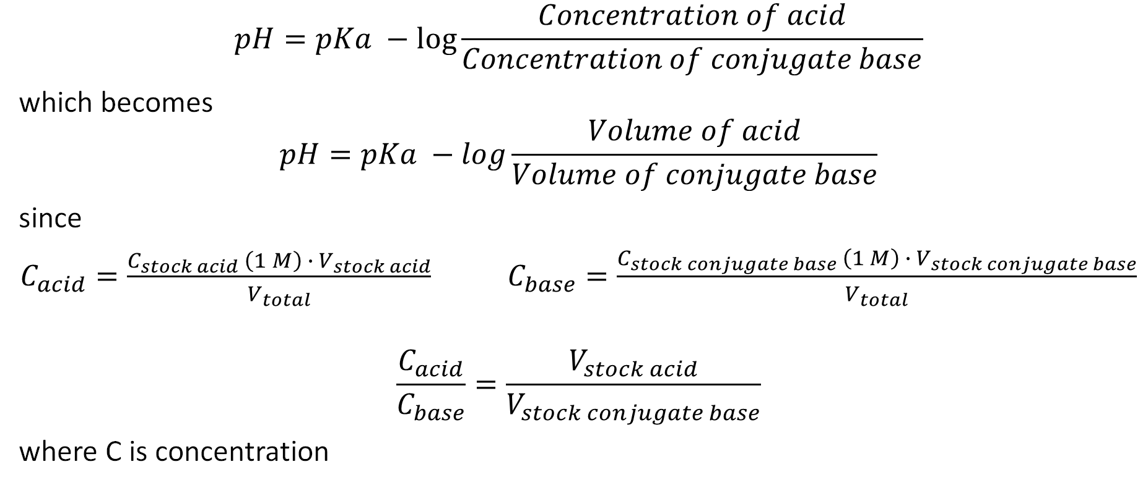
Henderson-Hasselbalch equation
$$pH=pKa −log⁡\frac{Concentration of acid}{Concentration of conjugate base}$$
which becomes
$$pH=pKa −log\frac{Volume of acid}{Volume of conjugate base}$$
since
$C_{acid}=\frac{C_{stock acid} \left(1 M\right) ∙{ V}_{stock acid}}{V_{total}}$ $C_{base}=\frac{C_{stock conjugate base} \left(1 M\right) ∙ V_{stock conjugate base}}{V_{total}}$
$$\frac{C_{acid}}{C_{base}}=\frac{V_{stock acid}}{V_{stock conjugate base}}$$
where C is concentration

Slide 34
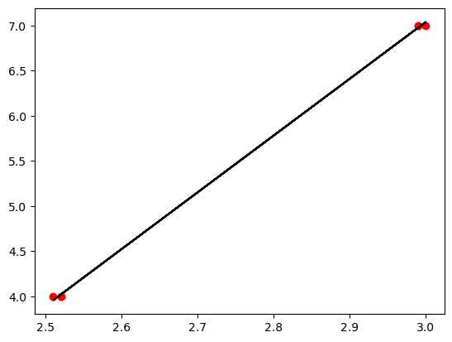
Calibrating sensor
pH = 6.291(voltage) -11.832
- Connect to Arduino (& pH sensor) from computer
- Take measurements for the voltage at known pH values (4 & 7)
- Graph the results (to establish a relationship between the pH and the outputted voltage)
- Use the equation of the best fit straight line to possibly modify the program (.ino file) to output the correct pH values
- In time, we converted the voltage to pH in Jupyter Notebook
pH
Voltage (V)

Slide 35
Understanding voltage outputs of a defective sensor
The first figure shows us the continually changing readings of the pH values from the Arduino (the blue stepped curve). As we aren’t able to wait so long for the values to completely stabilize (over 16 mins) we attempted to model the behavior of the readings (green and orange curves) to be able to predict their tendencies over a longer period of time.
However, as seen on the second figure, when given more time, the numbers stop following any kind of trend. This is caused by another factor, possibly electrolyte leakage from the sensor, which we are not interested in as we will not be taking measurements for so long. Fortunately, the response time of the new pH sensor was faster and the values were more stable after 30-60 seconds (the variation was <= 0.01 V).
All measurements were made on one solution.

Slide 36
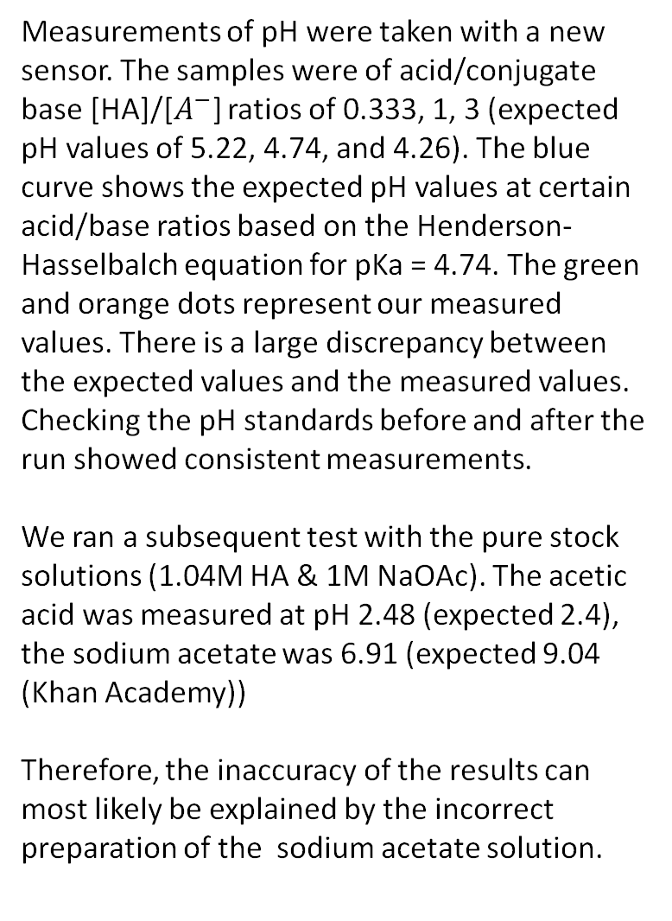
Finding the error in the stock reagents
Measurements of pH were taken with a new sensor. The samples were of acid/conjugate base [HA]/[$A^{−}$] ratios of 0.333, 1, 3 (expected pH values of 5.22, 4.74, and 4.26). The blue curve shows the expected pH values at certain acid/base ratios based on the Henderson-Hasselbalch equation for pKa = 4.74. The green and orange dots represent our measured values. There is a large discrepancy between the expected values and the measured values. Checking the pH standards before and after the run showed consistent measurements.
We ran a subsequent test with the pure stock solutions (1.04M HA & 1M NaOAc). The acetic acid was measured at pH 2.48 (expected 2.4), the sodium acetate was 6.91 (expected 9.04 (Khan Academy))
Therefore, the inaccuracy of the results can most likely be explained by the incorrect preparation of the sodium acetate solution.
HA represents acetic acid; A- represents acetate ions

Slide 37
pH sensors and electrode maintenance
pH sensors were purchased from DFrobot (https://www.dfrobot.com/product-1025.html )
pH sensor #1 (original provided by UMD): Because it was non-functional, the sensor was subjected to the Vernier shocking method (https://www.vernier.com/manuals/ph-bta/) using 0.5 M HCl and soaking overnight. After adjusting the trimpot, the sensor appears to be functional.
pH sensor #2 (new): After soaking overnight in fresh 3.3M KCl, the sensor was tested. It was then subjected to the Pasco protocol for restoring sensors (https://www.pasco.com/support/knowledge-base/21 ). There was little difference before and after the restoration procedure.
The trimpots (Bochen or Bourns 3296) on the board attached to the pH sensor were adjusted. I could rotate the screw at least 30 full turns clockwise and 20 full turns counterclockwise and never feel a stop. This behavior is unusual. The website says these are 25-turn pots but the data sheet does not state this. To increase the separation between the voltage values for the pH4 and pH7 standards, the trimpot was rotated ~11 turns counterclockwise.

Slide 38
Testing pH of a dispensed 1:1 solution
10 tests of a dispensed 1:1 solution after calibration of pH sensor
Average pH: 4.33
Variance: 0.004

Slide 39
Collecting data Pipetting & Calibrating & Measuring

Slide 40
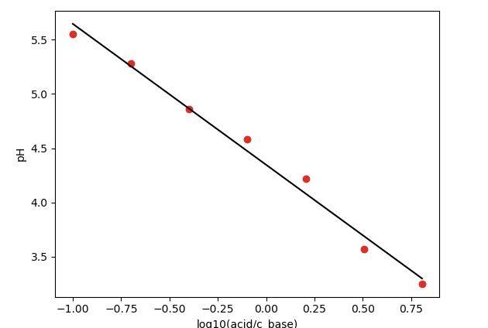
Pipetting & Calibrating & Measuring
This experiment involved pipetting 8 different acid/base samples into wells using code, calibrating the pH sensor using pH7 and pH4 standard solutions, and measuring the pH in each well from low to high ratios (only the 8th was unsuccessful due to a mistake in the code). The data shows that the higher the acid to base ratio, the higher the error in the results. A straight line was fitted to the data by configuring the data as (pH vs log10(acid/c_base)) and drawing a fit in python (see figure on the right). This gave us the slope (-1.3) and intercept (4.35). Measuring pH4 and pH7 showed that the pH readings had drifted to ~3.7 & 6.9 respectively.

Slide 41
Results of new experiment
The next day, using the same solutions as the previous day, we once again calibrated the pH sensor and measured the pH of 8 different samples. This time, we went in order of greatest acid/base ratio to smallest, to see if the deviation towards the end of our previous results was due to something that happened to the sensor or to the solutions throughout the experiment. The resulting offset was 4.43 and the exponent 1.03. According to theory, where no carbonic acid is accounted for, the offset (pKa) should be 4.74 and the exponent should be 1. It does seem that the pH readings as the experiment proceeds.
Did you use 0.1 M acetic acid and 0.1 M NaOAc?
pH = 4.43 - log(acid/cbase)

Slide 42
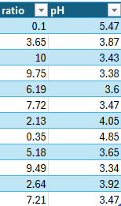
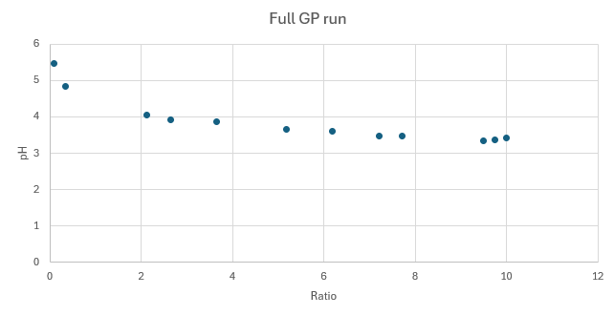
Full autonomous run with GP
We were able to run the program on Legolas from a single Python file and all in one run. The results are shown. GP output and subplots including the acquisition function and mean are in /plots/ on Github.
Did you use 0.1 M acetic acid and 0.1 M NaOAc?
Also show output of GP with the mean and confidence interval
Experimental data in the order in which the points were acquired are shown below.

Slide 43
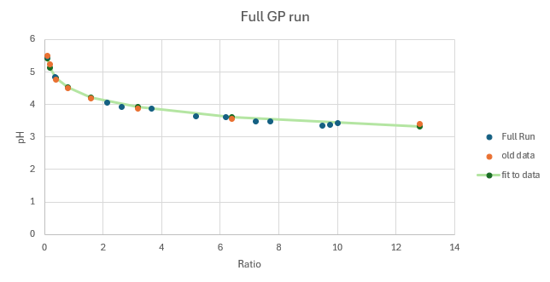
Full autonomous run with GP: overlay of measurement data from two experiments
The measurement data from the GP run lined up exactly with the data from the prior experiment where 8 solutions were pipetted followed by measurement of pH. The GP run shows that the measurements are repeatable. The solid green curve is the fit for the previous data.
pH = 4.43 - log(acid/cbase)

